Slide 1
Lego: The NXT Generation
Or
What I Did Last Summer
Linda Wallin
National-Louis University
The Center for Gifted
ICE 2010

Slide 2
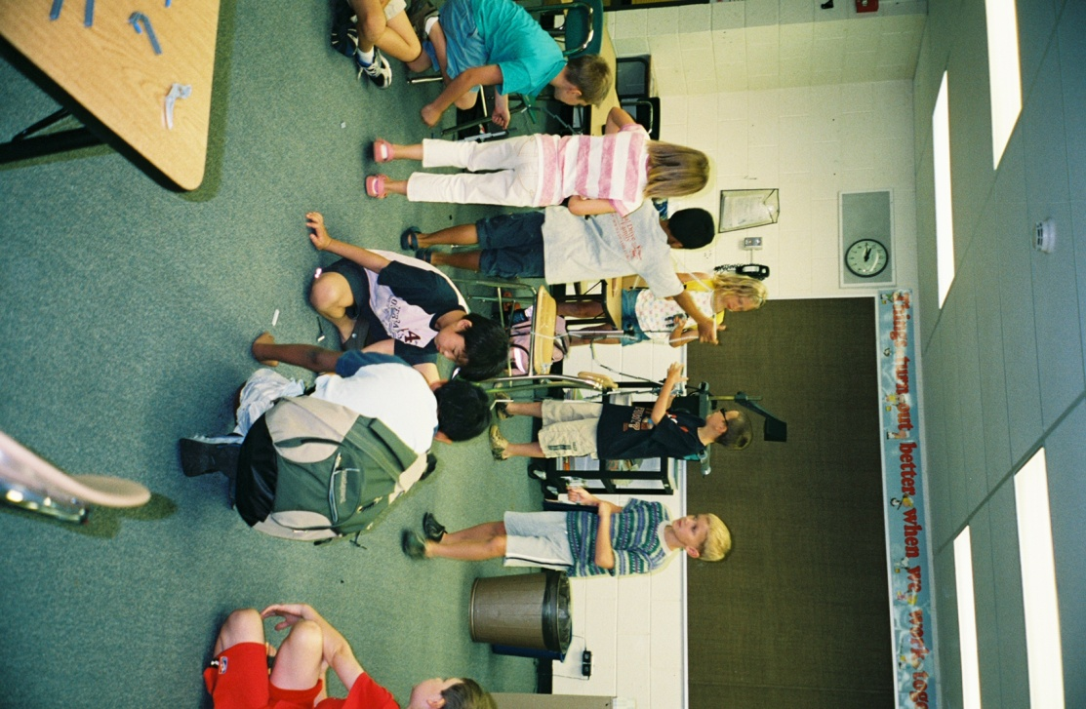
Lego: Danish for “play well.”
Since 1932
Family business
Present brick formed in 1958
Lego Duplo 1970
Play themes
NXT Mindstorms
Lego Education
Learning Institute
Notes:
“Leg godt.”
Duplo for preschool.
Play themes for Star Wars, Harry Potter, and Bionicle.
Lego Education has lesson plans that use Lego kits.
Institute includes Mitch Resnick, studies processing of spatial information.

Slide 3
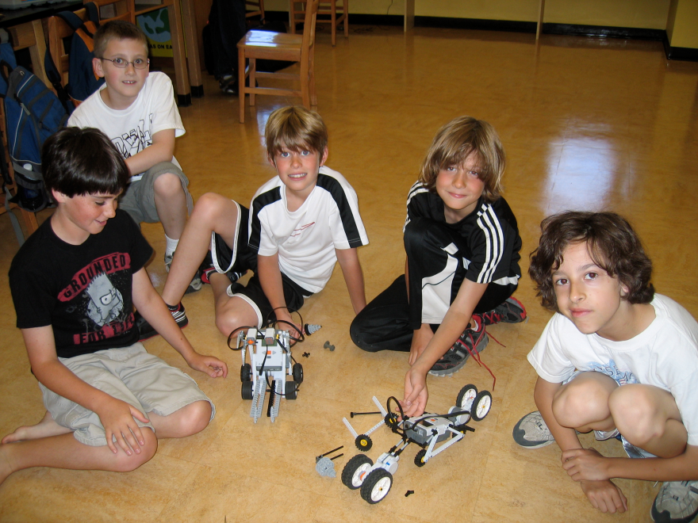
Center for Gifted
Summer Programs in
Chicago
Burr Ridge
Elgin
Elmhurst
Glenview
Gurnee
Naperville
Oak Forest
St. Charles
Buffalo Grove
Skokie

Slide 4
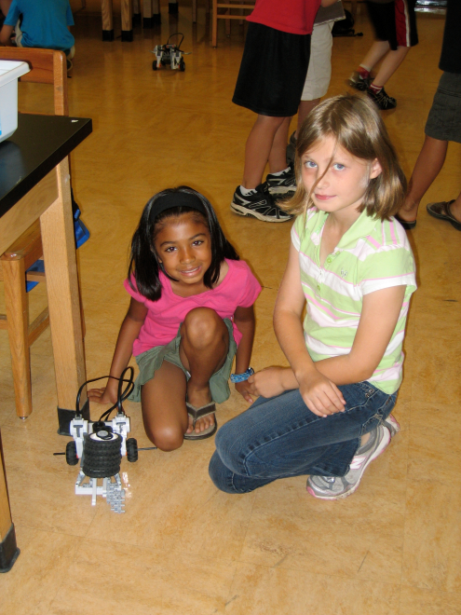

Gifted 101
High in language skills
Abstract ideas
Sensitivity
Curiosity
Independent
Maintain focus
Choose unusual topics
High energy
Older or adult friends
Characteristics of Gifted Learners
1. http://www.ri.net/gifted_talented/character.html
Notes:
Early readers and advanced vocabulary
Ease of use of abstract ideas
Sensitive to non-verbal cues
Intense curiosity
Work independently and for long periods
Unusual choices of learning and high ability to focus
High energy
Prefer older friends or adults
Intrinsic motivation

Slide 5
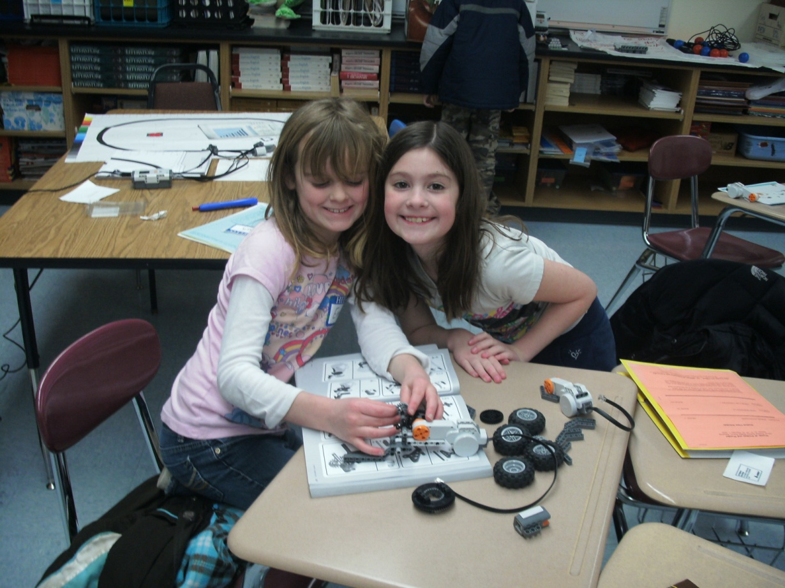
Curriculum
HOTS
Sef-directed
Challenging with abstract ideas
Intellectually demanding
Acceleration
Compacting
Variety
Reorganization
Flexible pacing
Complexity
Integration across subjects
Encouragement of unique interests
Notes:
Higher level thinking skills
Self-directed learning
Think about subjects in more abstract and complex ways
More intellectually demanding
Content, as well as learning experiences, can be modified through acceleration, compacting, variety, reorganization, flexible pacing, and the use of more advanced or complex concepts, abstractions, and materials.
more elaborate, complex, and in-depth study of major ideas, problems, and themes that integrate knowledge within and across systems of thought.
reconceptualize existing knowledge and/or generate new knowledge.
explore constantly changing knowledge and information and develop the attitude that knowledge is worth pursuing in an open world.
exposure to, selection, and use of appropriate and specialized resources. ²
2. http://www.kidsource.com/kidsource/content/diff_curriculum.html

Slide 6
Lego Mindstorms
NXT
Key Components
Bricks
Sensors
Connectors
Wheels
Motors
Claws
Balls
“Brain”
Software
Laptop (with or without Bluetooth)
Bring lots of batteries

Slide 7
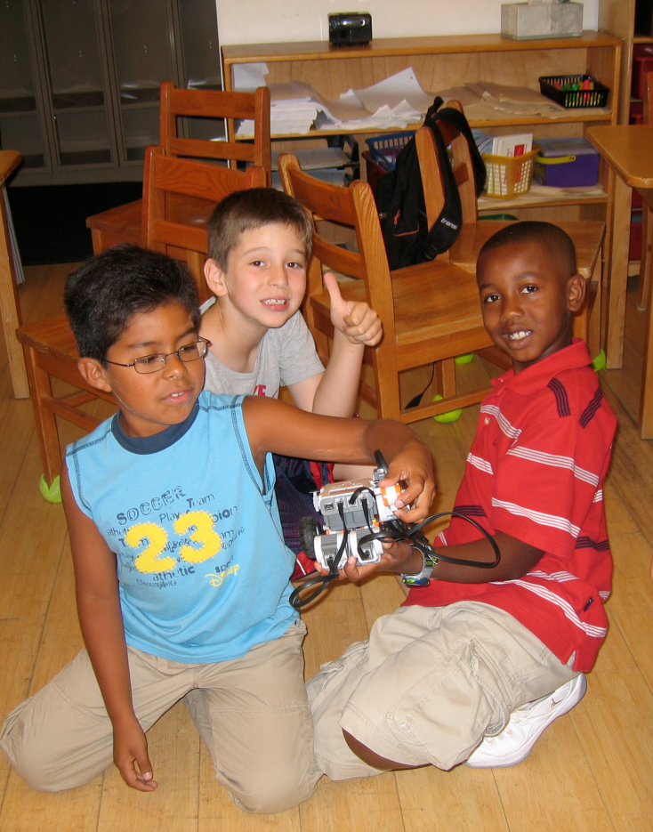
Teams
Name
Experience with Legos
Experience with Logo
Favorite things to do
Favorite web site
Notes:
Grouped according to similar interests

Slide 8
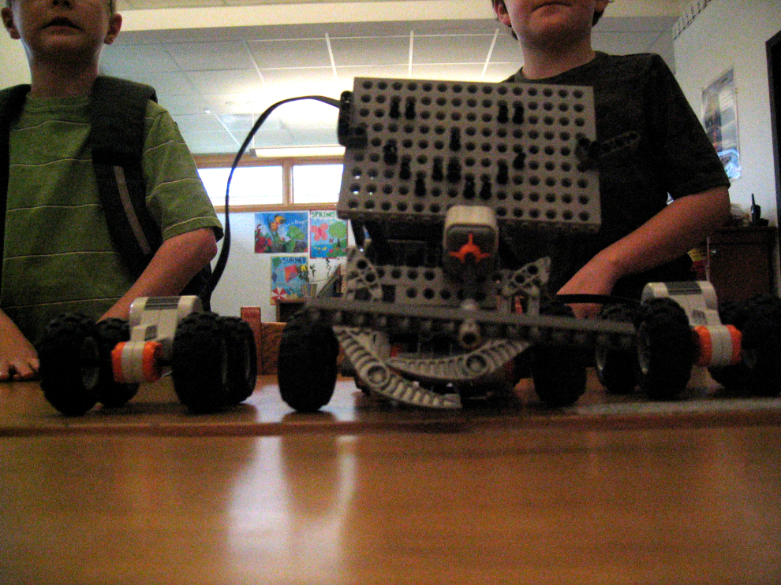
Week 1:
Learn how to hook up the parts
Explore the programs in the “brain”
Use firmware to create a simple program

Slide 9
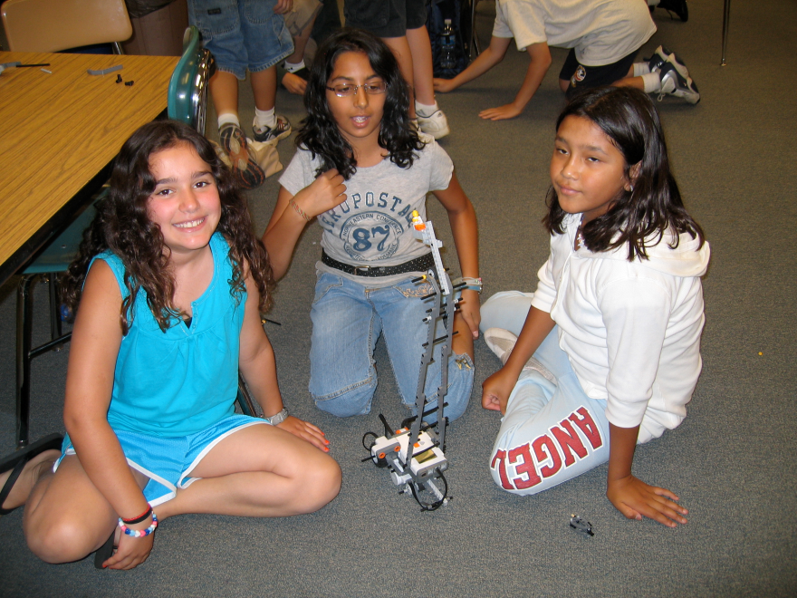
Week 2:
Begin Logo programming
Make machines with certain characteristics and a certain task.
Notes:
Make a sound, turn and be the tallest.
See who could use the most/least bricks
Move, make a sound, show a picture, fall apart

Slide 10
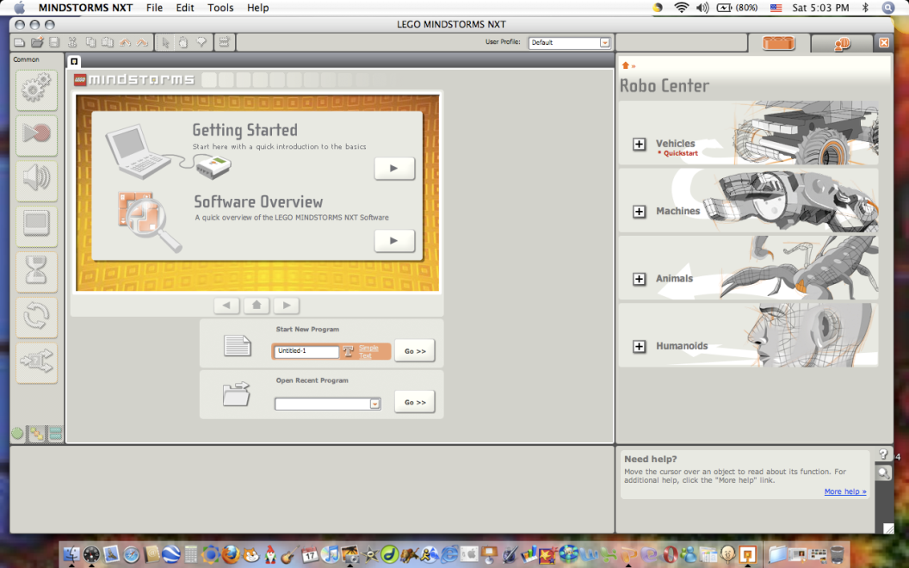
NXT program - Logo
Original Logo created by Seymour Papert, author of Mindstorms
Original program told a turtle to draw pictures on a screen
What a difference a generation makes!

Slide 11
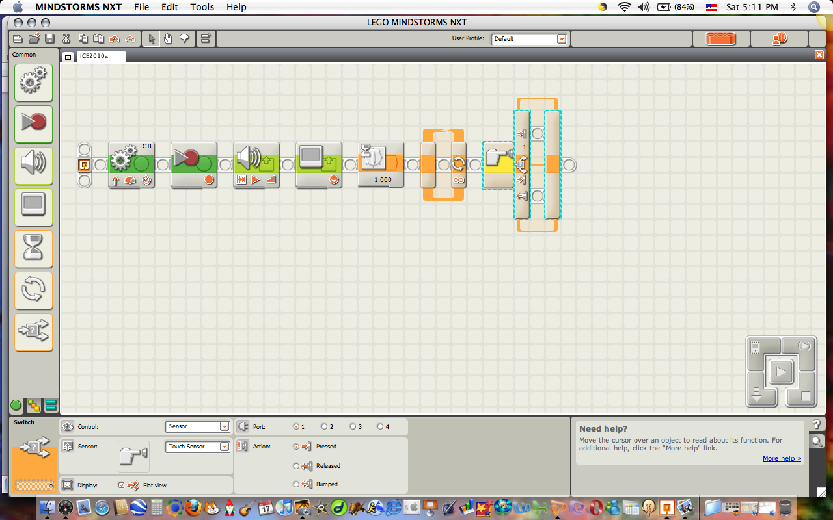
Graphical Interface

Slide 13
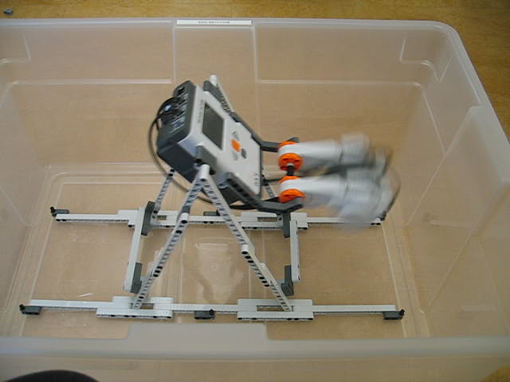

Slide 14
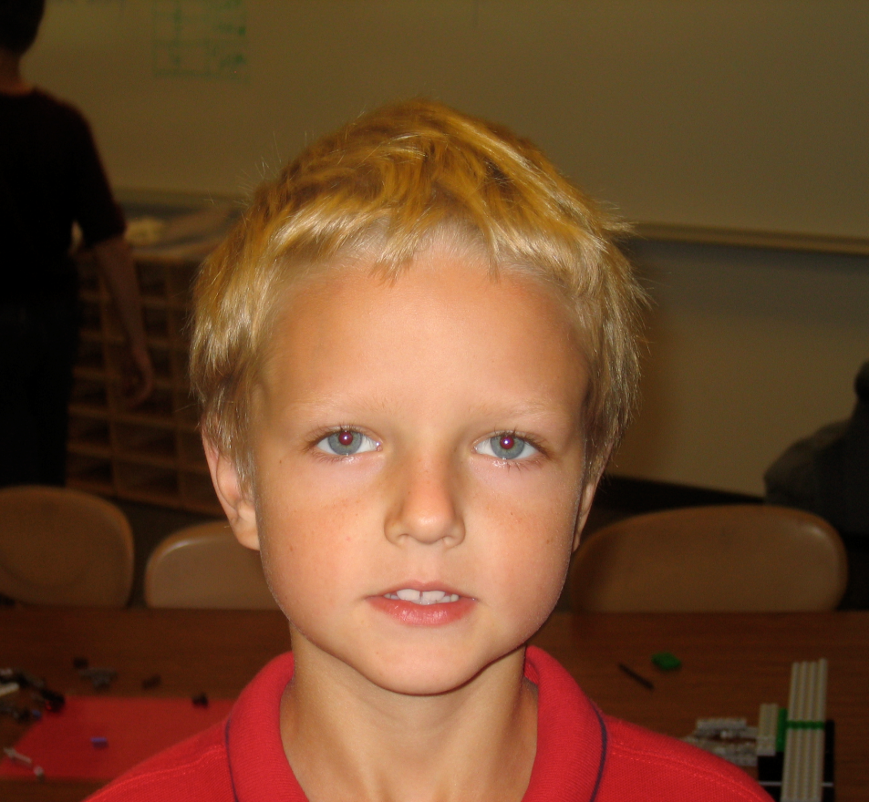
Programming
Program which used variables counted the number of times an object was waved in front of it, when the number reached five it stopped.

Slide 15
The kids explain

Slide 16
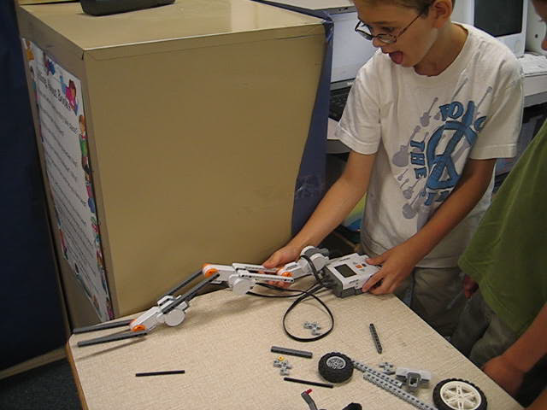

Slide 17
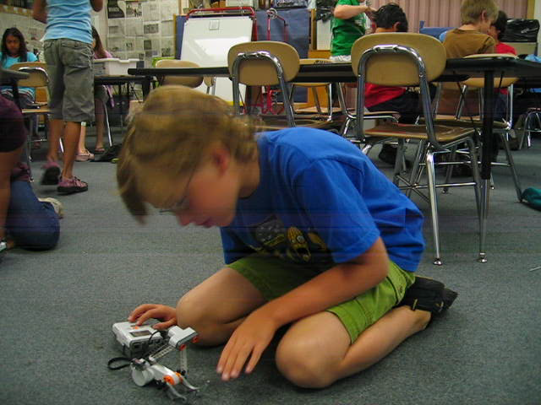

Slide 18
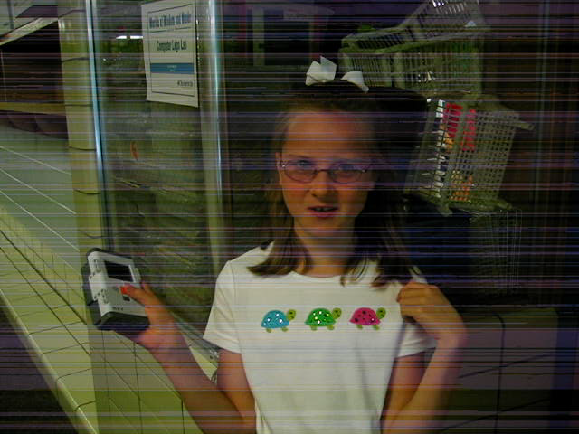

Slide 19
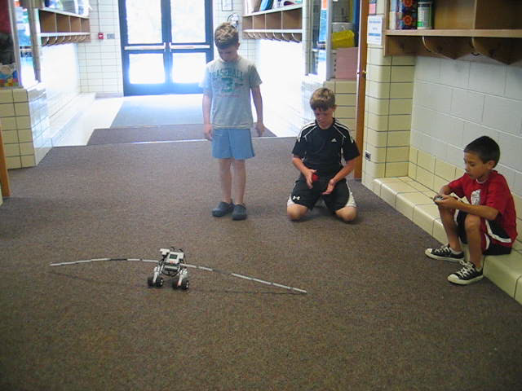

Slide 20
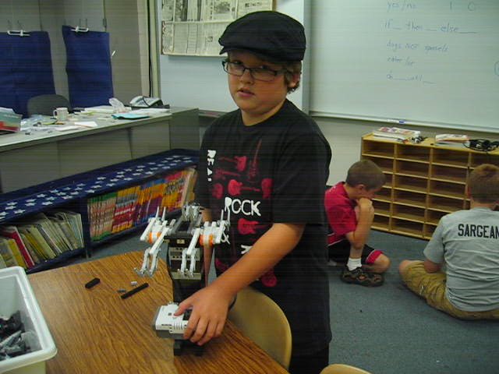

Slide 21
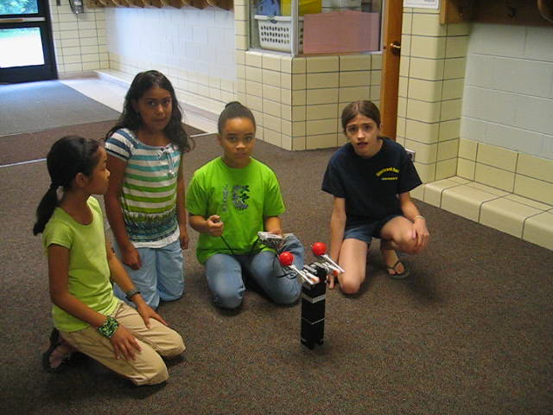

Slide 22
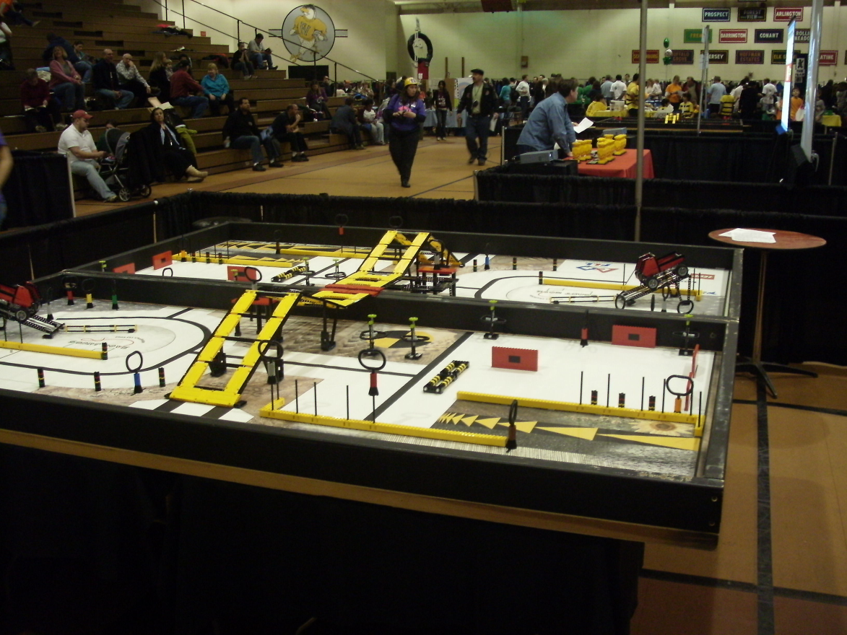
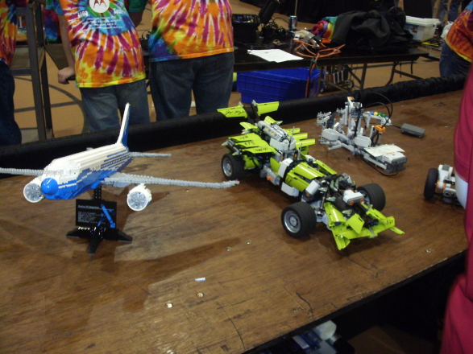
Competitions
First Lego League
World Robot Olympiad
Notes:
Challenge is presented to clubs in September.
FIRST stands for For Inspiration and Recognition of Science and Technology
Four programs: Research, development and training facility, Junior FIRST LEGO League (6-9), FLL for 9- 16, FIRST Tech Challenge (14-18) and FIRST Robotics Competition (14-18)
WRO has Primary, Junior High, and High School. Mostly in Asia

Slide 23
Resources
Lego Brickmaster Magazine ($40) for six magazines.
The Unofficial Lego Mindstorms NXT Inventor’s Guide, by David J. Perdue (very basic).
The Lego Mindstorms NXT Idea Book, by Boogaarts, Daudelin, Davis, Kelly, Levy, Morris, Rhodes, Rhodes, Scholz, Smith, and Torok (subtitled design, invent, and build)
LEGO MINDSTORMS NXT-G Programming Guide (Technology in Action), by James Floyd Kelly (this is an excellent book for teaching the programming language Logo, which is the language used with NXT).
Lego Mindstorms NXT Hacker’s Guide, by Dave Prochnow (only for advanced programmers).
www.dwna.net You can link to my blog from there.

Slide 24
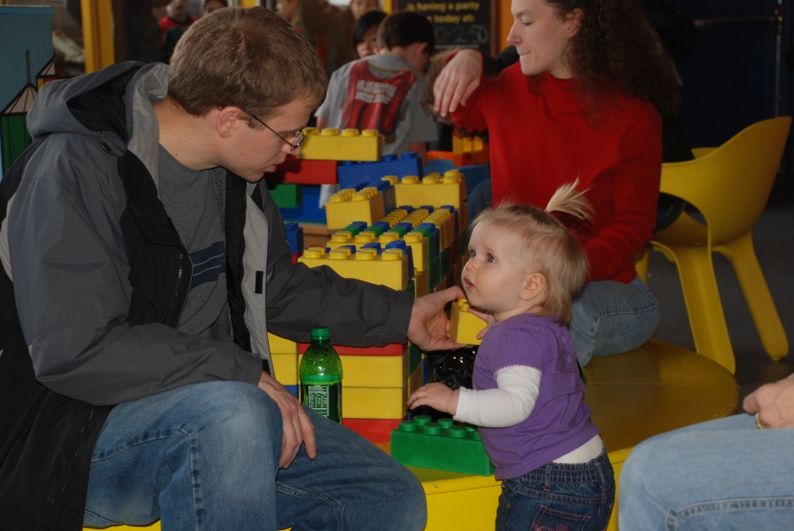
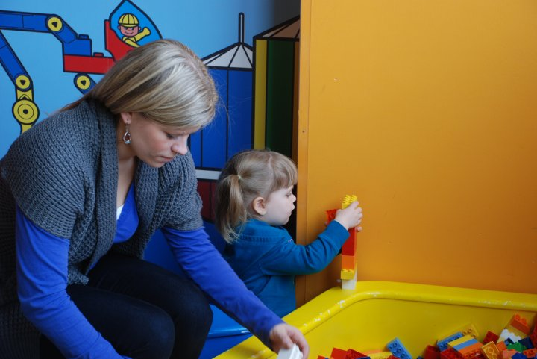
Don’t forget LEGOland

Slide 25
Thanks to
Joan Franklin Smutny, Director of the Center and National Treasure
Maria Freeman, Ph. D. Associate Director
Michael Gorelick, M.A. Technology
The parents that shared their children with me.

Slide 26
Live Long and Prosper

